Slide 1
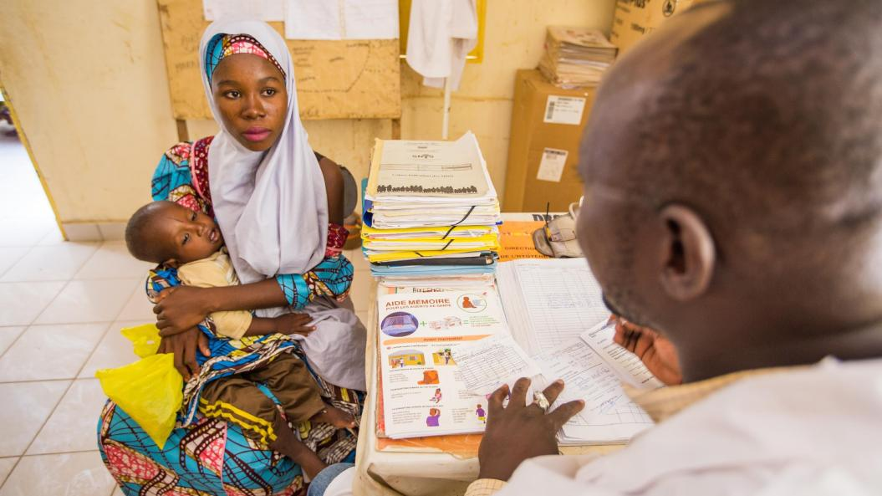

RBM Partnership Strategic Communications Partner Committee update

Slide 2
SCPC's Objectives
1
Shape a global narrative and align the global community to communicate and reinforce the benefits of ending malaria and what it takes – political will, funding, innovation, programmatic changes, etc.
2
Create and coordinate events and campaigns to increase awareness and a sense of urgency, and to drive actions that will accelerate ending malaria.
3
Connect malaria to the broader sustainable development agenda and build inclusive and multi-sectoral coalitions to increase financial and political support for and catalyze actions
4
Enhance sustainability of malaria advocacy efforts at global and country levels to catalyze and hold leaders accountable for actions that will accelerate ending malaria

Slide 3




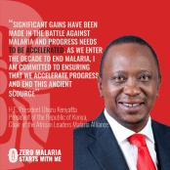
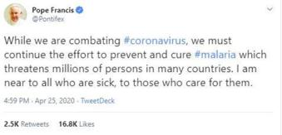

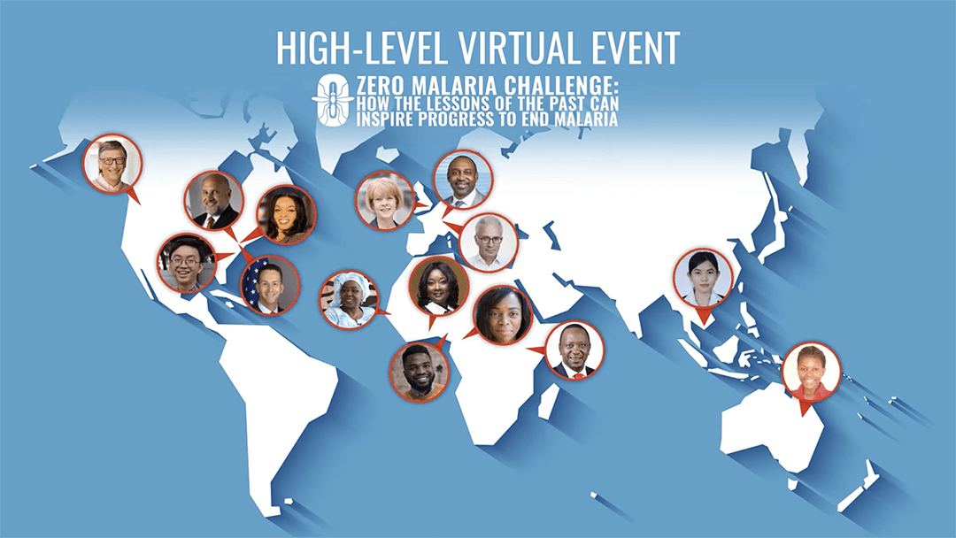
Driving actions to #endmalaria

Slide 4

November 2021:
Malaria Day in the Americas
SADC Malaria Day
Expo 2021 (Dubai, UAE)
UN Climate Change conf. (Scotland)
Publication of WHO World Malaria Report
September 2021:
76th UNGA (New York, USA)
Asia-Pacific Malaria Week
July 2021:
ZMSWM 3rd anniversary
AIMF annual meeting (Kigali, Rwanda)
Africa-France Summit (Montpellier, France)
August 2021:
World Mosquito Day
Olympic Games (Tokyo, Japan)
June 2021:
China’s malaria free certification
Launch of the gender and malaria investment roadmap
Generation Equality Forum
December 2021:
OIF Summit (Djerba, Tunisia)
October 2021:
G20 Summit (Rome, Italy)

Slide 5
SCPC Workstreams
Workstream | Lead
Campaigns | Vicky Gashe and Xenya Scanlon
Champions (joint with ARMPC) | Tara Bracken and Olivia Ngou
Francophonie (joint with ARMPC) | Yacine Djibo and Pauline Mazue
Media | Vacancy
Messaging | Michal Fishman
Youth (joint with ARMPC and CRSPC) | Ndifanji Namacha and Winter Okoth
Innovation (joint with ARMPC) | Lisa Goldman Van-Nostrand and Alex Fullem
Notes:
two approaches - time-bound ones and ongoing/ad-hocs ones

Slide 6

Any comments/questions?

Slide 7
Thank you!
To contact us, please email: scpc@endmalaria.org scpc@endmalaria.org pc@endmalaria.org

